Slide 1

SQL Murder Mystery
Winter Internship by Harshitha Chandaluri

Slide 2
A Detective’s Journey through SQL CITY
PROBLEM STATEMENT:
There's been a Murder in SQL City! The SQL Murder Mystery is designed to be both a self-directed lesson to learn SQL concepts and commands and a fun game for experienced SQL users to solve an intriguing crime.
A crime has taken place and the detective needs your help. The detective gave you the crime scene report, but you somehow lost it. You vaguely remember that the crime was a ​murder​ that occurred sometime on ​Jan.15, 2018,​ and that it took place in ​SQL City​.

Slide 3
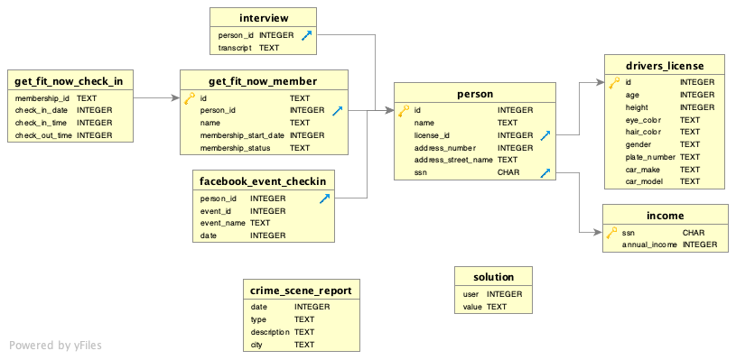
The Schema

Slide 4
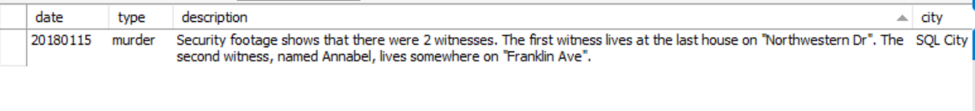
Retrieve Crime Scene Report:
Run a query to retrieve the crime scene report for the murder that occurred on Jan.15, 2018, in SQL City. Gather all available details from the report
select *from crime_scene_report where date =20180115 and city ='SQL City' and type = 'murder' ;

Slide 5

Witness Personal Details
Check the personal details of witnesses involved in the case. Retrieve their names, addresses, and any other relevant information
select *from person where address_street_name='Northwestern Dr'order by address_number DESC LIMIT 1;
select *from person where address_street_name='Franklin Ave' and name like '%Annabel%';

Slide 6
View Witness Interviews
Access the recorded interviews of witnesses conducted after the murder. Gather insights into their statements and potential clues.
select *from interview where person_id = 14887;
select *from interview where person_id = 16371;

Slide 7


Check Gym Database
Investigate the gym database using details obtained from the crime scene report and witness interviews. Look for any gym-related information that might be relevant.
select * from get_fit_now_check_in where check_in_date=20180109 and membership_id like '48Z%';
select *from get_fit_now_member where id ='48Z7A' or id='48Z55'and membership_status='gold';

Slide 8
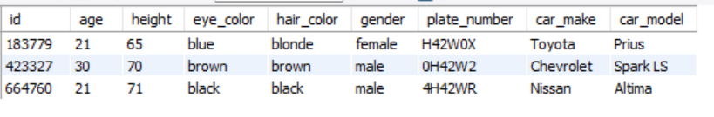
Check Car Details
Examine the car details associated with the crime scene. Retrieve information about the vehicles present during the incident.
select *from drivers_license where plate_number like '%H42W%' ;

Slide 9
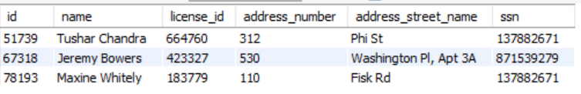
View Personal Details
Identify and collect personal details mentioned in the previous query. This includes names, addresses, and any additional details.
select *from person where license_id in (select id from drivers_license where plate_number like '%H42W%');

Slide 10

Membership Status at the Gym
Determine who is identified in the previous query as a member of the gym. Utilize the gym database to confirm their membership status.
select *from get_fit_now_member where id ='48Z7A' or id='48Z55'and membership_status='gold';

Slide 11

Analyze and Draw Conclusions
Task: Analyze the collected data, including crime scene reports, witness interviews, gym records, and car details. Draw conclusions or hypotheses based on the information available.
with cte1 as
(select *from person where l icense_id in (select id from drivers_license where plate_number like '%H42W%’)),
cte2 as
(select person_id,name,membership_status from
get_fit_now_ member where id ='48Z7A’ or id='48Z55’ and membership_status='gold’)
select cte1.id,cte1.name, cte2.membership_status from cte1,cte2 where cte1.id=cte2.person_id;

Slide 12
Identifying the Mastermind behind the Murder
select *from interview where person_id=67318;

Slide 13

Identifying the Mastermind behind the Murder
SELECT
p.name, d.height, d.hair_color, d.car_make, d.car_model, d.gender FROM person as p JOIN drivers_license as d ON p.license_id=d.id
WHERE d.height BETWEEN 65 AND 67 AND d.hair_color='red' AND gender='female’ AND car_make='Tesla' AND car_model='Model S’
AND p.id IN (SELECT f.person_id FROM facebook_event_checkin as f WHERE F.event_name='SQL Symphony Concert');

